Slide 1
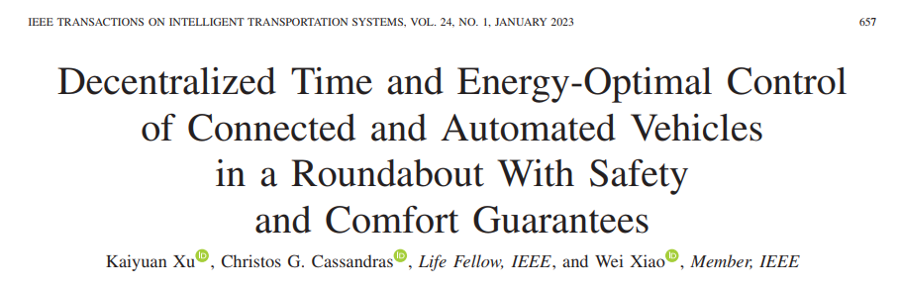
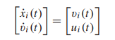
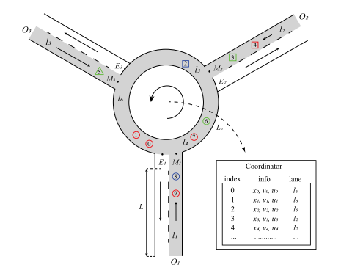
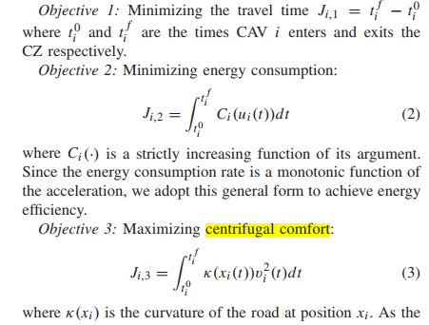

Slide 2
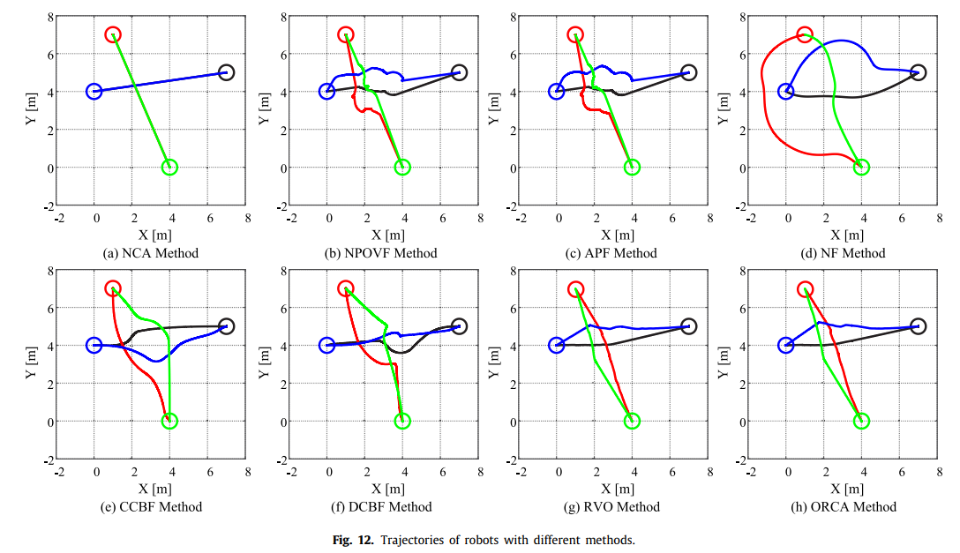
Gao Yan, Bai Chenggang, Quan Quan. A Non-Potential Orthogonal Vector Field Method for More Efficient Robot Navigation and Control 【J】. Robotics and Autonomous System, 2022, DOI: 10.1016/j.robot.2022.104291

Slide 3
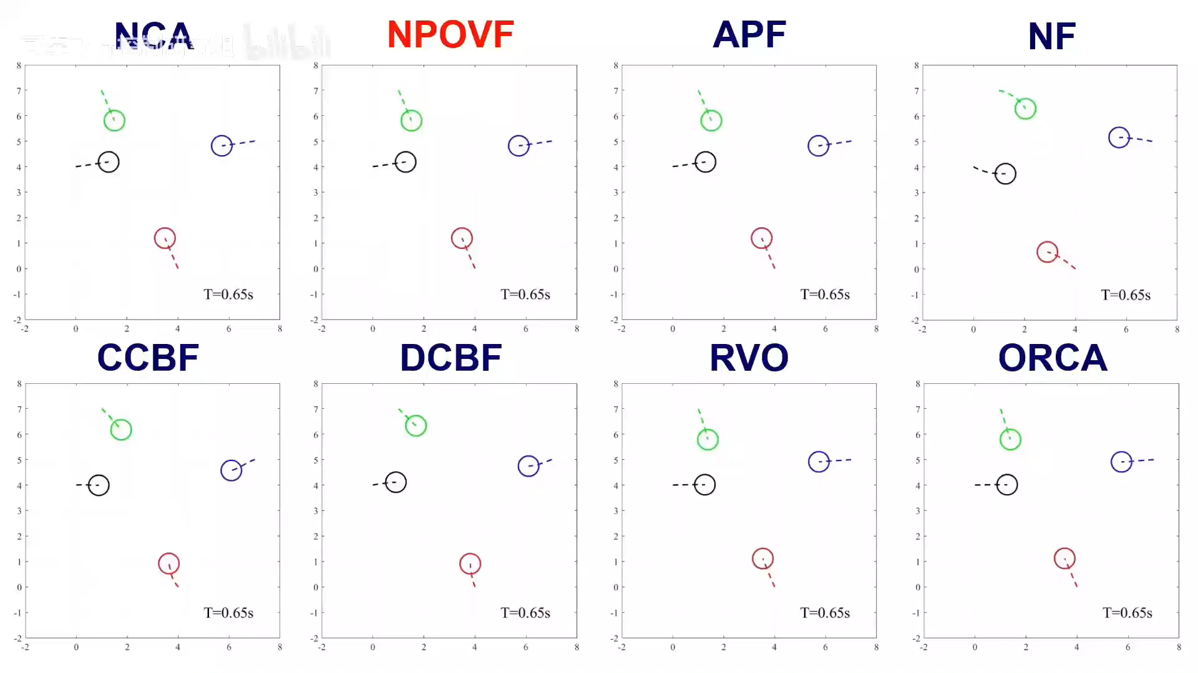

Slide 4
Input:
Center_ini=0.5*(p_start+p_dest)
Start point , Destination , Coordination radius R
Aims:
Safe and efficient
Step1: Formation on the circle
Check the exit point (about 30°)
Step2: Go to the destination

Slide 5
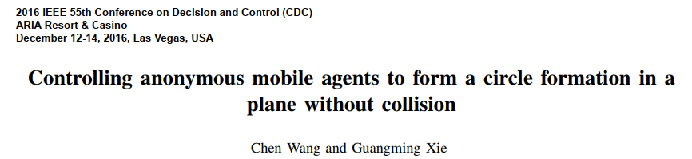
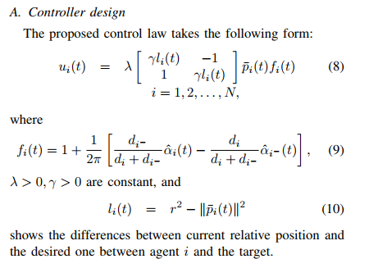
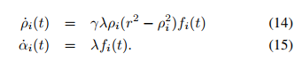
Step1: Formation on the circle

Slide 6


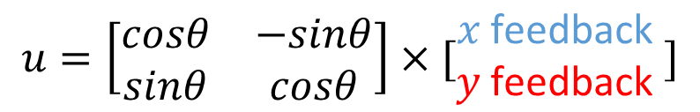
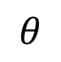
Step2: Go to the destination
$x$ feedback
$$θ$$
$y$ feedback
$$u=\left[\begin{matrix}cosθ & −sinθ \\ sinθ & cosθ\end{matrix}\right]×[\begin{matrix}x \text{feedback} \\ y \text{feedback} \end{matrix}]$$
X
counter clockwise rotation matrix

Slide 7
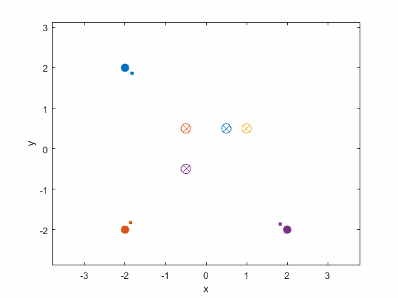

Slide 8
